Slide 1
Data Visualization
Matplotlib

Slide 2
Why Data Visualization
“A picture is worth a thousand words”
First step of data analysis.
Provides an intuitive understanding of data.
Assists in picking patterns and outliers.
Visual representations enhances the human cognitive process.

Slide 3
Benefits of Data Visualization
Allows different perspectives of data
Cognitive processing and prediction strategies
Interpret vast amounts of data

Slide 4
Matplotlib
Matplotlib is a python package 2D visualization (aka arrays)
Built on NumPy arrays and designed to work with the broader SciPy stack.
Supports both quantitative (pie, bar, histogram) and rate of change (line, scatter)
from matplotlib import pyplot as plt or
import matplotlib.pyplot as plt

Slide 5
Objectives
Data visualization:
2D:
Pie Chart
Bar Plot
Grouped Bar Plot
Histogram
Line Plot
Scatter Plot
Subplot
3D
Contour Plot
Surface Plot
Mesh Plot
What’s so special about Each of these plot types?

Slide 6
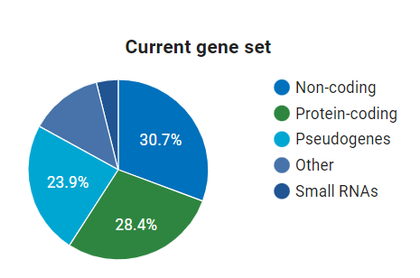
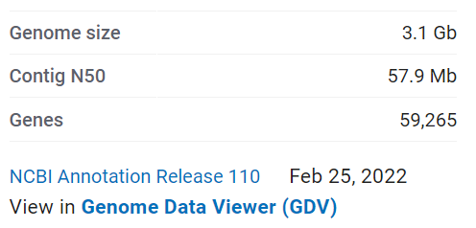
Pie Charts
Homo sapiens - NCBI - NLM (nih.gov)
If you have several parts of something whole, you can demonstrate in one pie chart.
In a pie chart, the area of each slice is proportional to the quantity it represents.
NCBI Reference genome GRCh38.p14

Slide 7
Bar Charts
A bar chart shows comparisons among discrete categories.
One axis of the chart shows the specific categories being compared, and the other axis represents a measured value.
Tiktok
Twitter
Instagram
Daily usage (Relative)
Snapchat
LinkedIn
Communication Apps

Slide 8
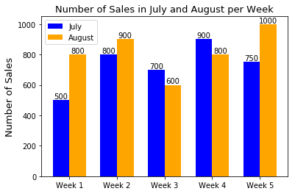
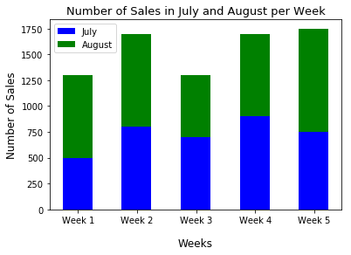
Grouped and Stacked Bar Plots
Grouped Bar plots are used for comparing sizes of individual groups of categorical data
Stacked Bar plots are used to show total size of the groups along with individual players in the group.
Courtesy Dr. Ting, UNT COI

Slide 9
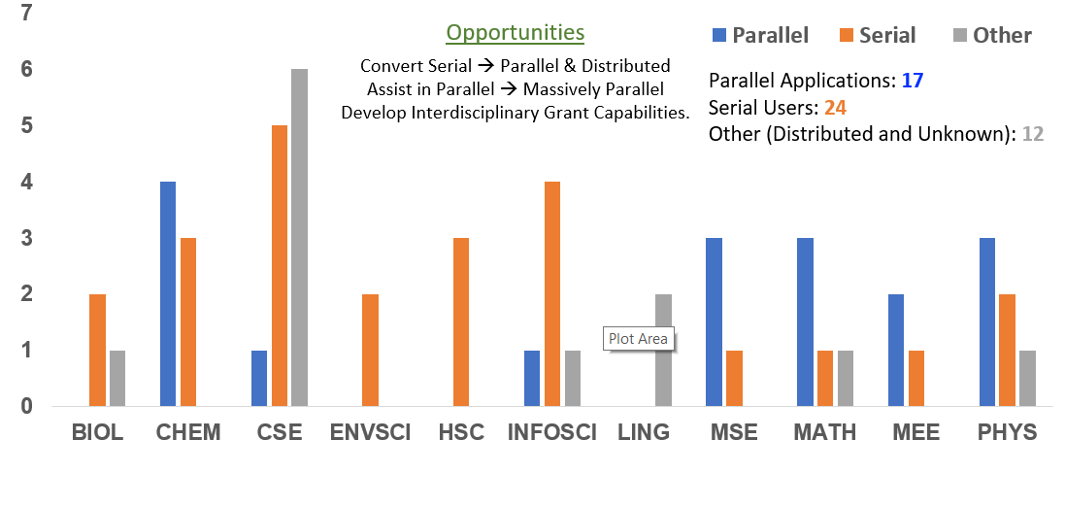
Stacked Bars for Business Development

Slide 10
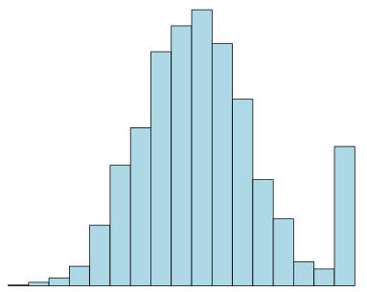
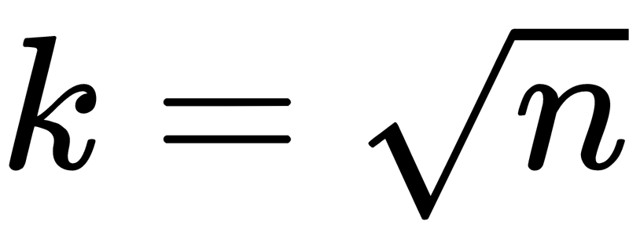
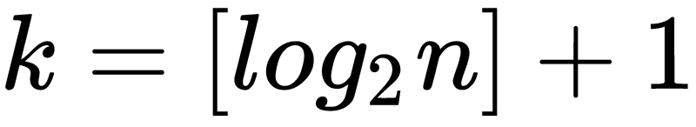
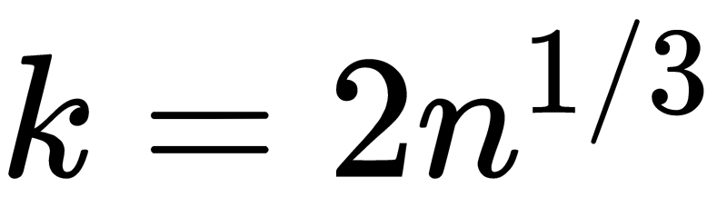
Histograms
A histogram displays numerical data of a parameter and is grouped by equal number of bins.
Height of the bin represents how many data points are in that bin.
Bins are also sometimes called intervals, buckets, or classes.
Square Root Method:
Height of the Bin
Bin Width
Sturges Formula
Rice Rule
How to calculate the bin width?

Slide 11
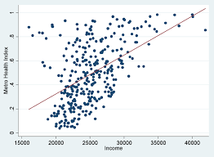
Scatter Plot
Scatter plot represents a relationship between two sets of data
Goal is to understand (rather intuitively) their relationship as a starting point
Minnesota Public Health dataset showing income inequalities in health outcomes
https://www.health.state.mn.us/communities/practice/resources/phqitoolbox/scatterplot.html

Slide 12
Matplotlib for 2D plots
import matplotlib.pyplot as plt
Line plot: plt.plot(x, y)
Scatter plot: plt.scatter(x, y)
Subplot: plt.subplot(nrows, ncols, index)
Bar: plt.bar(x,y)
Histogram: plt.hist (y)
COMPUTER SCIENCE

Slide 13
Object Oriented Method
A better way to create plots
import matplotlib.pyplot as plt
fig = plt.figure() # create a figure object
ax1 = fig.add_subplot(221) # create a subplot object
ax1.set_ylabel('y label') ax1.set_xlabel('x label') ax1.scatter(x,y)
COMPUTER SCIENCE

Slide 14
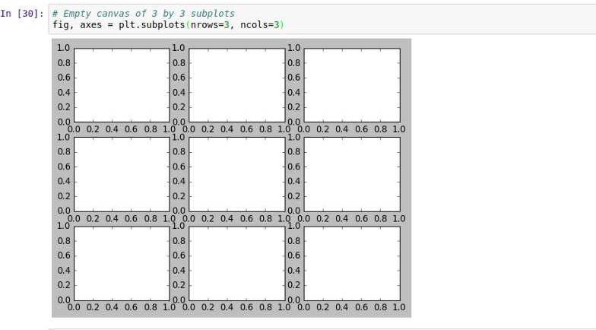
Matrix of subplots

Slide 15
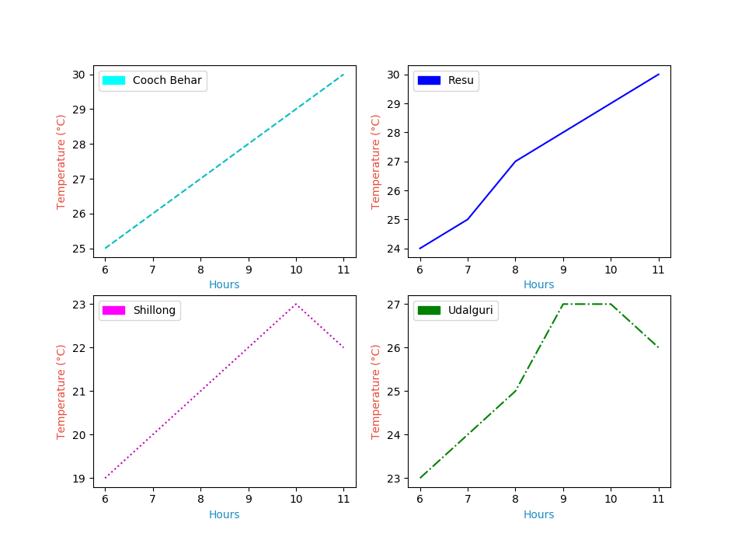
Subplots
Show multiple plots on a single figure
Compare different views of the data side by side.
Courtesy Dr. Ting, UNT COI

Slide 16
References
https://www.simplifiedpython.net/data-visualization-python-tutorial/
https://matplotlib.org/
https://mode.com/blog/python-data-visualization-libraries/
https://towardsdatascience.com/top-6-python-libraries-for-visualization-which- one-to-use-fe43381cd658

Slide 17
Tutorials
2D plots

Slide 18
Introduction to Big Data and Data Science
Data Visualization
Outcomes
Contour Plots
Surface Plots
Publication quality graph(ics)

Slide 19
Libraries Needed
matplotlib.pyplot
numpy
meshgrid()
Creates a rectangular grid from an array of x and y values.
Replaces loops in python with a vectorized operations
Countour()
Represent a 3D in a 2D map
Changes are represented by spacing between contours.
Contourf() (for filled contours)
Draws filled contours
Different colors help see changes better (e.g., heatmap analysis)

Slide 20
Functions()
Anti-aliasing: Removing signal components that can't be resolved. Such as minimizing image distortion effects when high resolution image is read by a low-resolution device. Computationally Expensive!
Mesh Plots
from matplotlib import cm
from matplotlib.ticker import LinearLocator
surf = ax.plot_surface(X, Y, Z, cmap=cm.coolwarm, linewidth=0, antialiased=False)
Surface Plot
from mpl_toolkits.mplot3d import Axes3D
ax = plt.axes(projection='3d')
ax.plot_surface(X,Y,Z) #X,Y,Z are 2D array data values
Heatmaps
color_map = plt.get_cmap('hot')
surfplot = ax.plot_surface(X,Y,Z, cmap=color_map, edgecolor='none')
fig.colorbar(surfplot,ax=ax, shrink=0.5, aspect=5)

Slide 21
Objectives
Data visualization tasks:
Pie Chart
Bar Plot
Grouped Bar Plot
Histogram
Line Plot
Scatter Plot
Subplot
Contour Plot
Surface Plot
Mesh Plot
How to make publication quality figures
What/Why Contour Plots?
Contour plot captures changes as f(X,Y) in 2D graph!
Look for spacing between contours!
Space is tight: change is rapid!

Slide 22
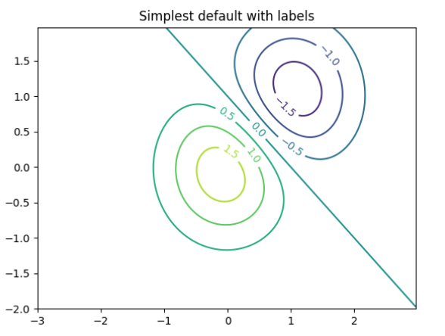
Contour plot with Python
fig, ax = plt.subplots()
CS = ax.contour(X, Y, Z)
ax.clabel (CS, inline=True, fontsize=10)
ax.set_title ('Simplest default with labels')
import numpy as np
import matplotlib.cm as cm
import matplotlib.pyplot as plt
delta = 0.025
x = np.arange(-3.0, 3.0, delta)
y = np.arange(-2.0, 2.0, delta)
X, Y = np.meshgrid(x, y)
Z1 = np.exp(-X**2 - Y**2)
Z2 = np.exp(-(X - 1)**2 - (Y - 1)**2)
Z = (Z1 - Z2) * 2
Clabel:
Controls data labels from overlapping on contours
CS: ContourSet object returned by Contour().

Slide 23
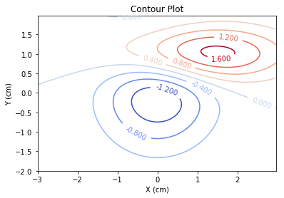
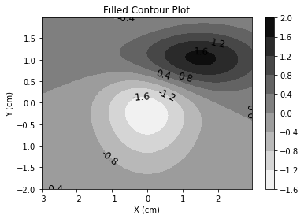
Contour Plots
import matplotlib.pyplot plt
plt.contour()
Show a 3D surface on a 2D plane.
Each contour line is shown in an X-Y plot and has a constant Z value.
Look for peaks, valleys in contour plots!
plt.contourf(X,Y,Z)

Slide 24
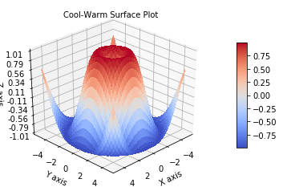
Surface Plots
Plot 3D data
Shows a functional relationship between a designated dependent variable (Z), and two independent variables (X and Y).

Slide 25
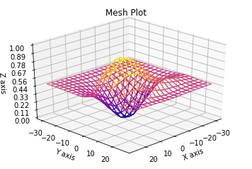
Mesh Plots
Like Surface plots (represents 3D data)
Displays surfaces that color only the lines connecting the defining points.

Slide 26
How to make publication quality figures

Slide 27
Making Publication Quality Figures
Make sure the figure fits with the context of where it is going to be used.
Figure outline: What data do you want to show and how?
Purpose: poster or paper?
Submission instructions: size, resolution, etc.

Slide 28
Making Publication Quality Figures
Get a reasonable, rough visual
Pilot/prototype the plot:
Pick plots that represent your data well.
Examples: pie, histogram, surface, etc.
Configure the plot area to highlight the areas of interest
Choose the right form: pie chart or bar chart, scatter plot or line plot, a single plot or subplots
(Goal: Represent data relationships suitably)

Slide 29
Making Publication Quality Figures
Add the basics to make figures speak for themselves
a figure title
x-axis label (with units)
y-axis label (with units)
a legend
a figure caption
critical text or shape annotation

Slide 30
Making Publication Quality Figures
Format Your Plot (for range, expression, fonts, etc.)
Fix Limits: X-axis and Y-axis
Change the figure size
Change line colors, types, and data point markers
Make major tick marks minimal to give room for labeling
Change font sizes
Change the aspect ratio
...

Slide 31
Making Publication Quality Figures
Save in a vectorized format (.svg, .pdf, .eps) rather than a raster format (.jpg, .png, .gif, etc)
Raster graphics (.jpg, .png, .gif, etc): These formats save the image as a collection of X by Y pixels.
Vector graphics (.svg, .pdf, .eps): These formats define the image using geometric shapes - lines, circles, text by fonts and sizes, etc.

Slide 32
Making Publication Quality Figures
Finishing touches with image editing software
Example raster graphics editors:
Gimp (free!)
Adobe Photoshop
Example vector graphics editors:
Inkscape (free!)
Adobe Illustrator

Slide 33
Tutorials
3D plots
Publication Quality Figures

